Slide 1
Digital lives: apps, social media and sex

Slide 2
Digital lives: apps, social media and sex
By the end of this session participants will have:
Developed a greater awareness of how gay, bisexual and MSM use apps and social media and how this impacts on their social and sexual lives.
Recognised which aspects of men’s use of apps and social media might be relevant to consideration of HIV/STI risk.
Understood the value of discussing how men use apps and social media in the context of a sexual health service.

Slide 3
Digital lives: apps, social media and sex
Terminology
The term social media refers to how people create, share and exchange information and ideas in virtual communities and networks, for example using a site like Facebook.
Commercial companies provide apps that facilitate contact between people; these apps can be downloaded on to your mobile device; this could be a message service like WhatsApp or Instagram the photo sharing service.
A growing number of these apps and websites target gay and bisexual men who use them to facilitate contact. The most used site you might have heard of is Grindr but there are many others including Recon, Gaydar, Squirt, Fitlads, Scruff, GROWLr

Slide 4
Digital lives: apps, social media and sex
Terminology
Different apps can be a forum for specific interests or attractions. So, for example Recon would attract men interested in fetish sex. Or an app like Growlr would be of interest to men who are part of the gay bear community. Talking with men about the apps they use might give insight into the sex they are considering or having.
There has been a shift from people using a website on their PC to using an app on their phones or iPad/tablet when networking with others.
Apps like Grindr use GPS technology so that when a man views another man who is online they can see how far away that potential contact is.

Slide 5
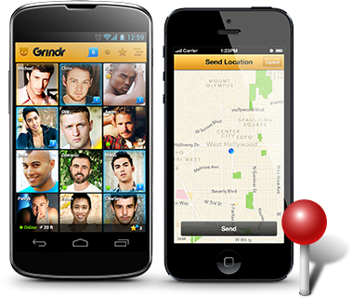
Digital lives: apps, social media and sex
How does an app like Grindr work?
Watch our commissioned film.

Slide 6
Digital lives: apps, social media and sex
Discussion
Would you say you are confident using or understanding social media?
How familiar are you with the apps and social media that gay and bisexual men use to meet others?
There may be an assumption that meeting men for sex via an app or social media is in itself more ‘risky’ in terms of men having condomless anal sex. What’s your view on this?

Slide 7
Digital lives: apps, social media and sex
Digital Lives and HIV/STI risk: Research evidence
For all of us, how we live our lives online is changing quickly, but in terms of our interest here today, findings from research identify a number of issues and themes that address the internet as a ‘risky’ place. This and the next slide describe some of this research. A note of caution – with the technology developing quickly it is easy for research in this field to become (and sound) out of date.
Klein (2012) identifies that the internet facilitates a desire for anonymous sex which is associated with HIV related risk practices such as condomless anal sex, larger partner numbers and drug use.
Sowell and colleagues (2010) identify the internet as “an effective method of seeking unsafe sex”, particularly for married men. Their work also points to the interest in younger men seeking older men, and older men seeking younger men.

Slide 8
Digital lives: apps, social media and sex
Digital Lives and HIV/STI risk: Research evidence
McKirman and colleagues (2006) propose that internet-based contacts might facilitate cognitive escape from the demands of safer sex, in time men’s behaviour becomes more risky. They talk about “a pressure toward risk”.
Some research suggests that while it is not possible to show a causal relationship between the internet and risky sex the internet might be viewed as “a risk environment”. (Zhang 2007)
Horvath and colleagues (2008) conclude that meeting partners online does not in itself promote or discourage condomless anal sex. They emphasise that being drunk or using drugs are the significant risks.
The US Centre for AIDS Prevention Studies (2007) reports “whether or not the internet’s unique qualities contribute to risk-taking behaviours is not fully understood”.

Slide 9
Digital lives: apps, social media and sex
Digital Lives and HIV/STI risk: Research evidence from Scotland
In 2013 Jamie Frankis and colleagues at Glasgow Caledonian University published their work on ‘Social Media, Lanarkshire Men who have Sex with Men and Sexual Health’. Key findings include:
In areas without gay commercial venues, gay social media has transformed the mutual visibility of gay men who are using these networks.
The online self is a constantly changing construct, dependent on current sexual needs or the desire to be found attractive and popular.
Social media enables explicit sexual negotiation, HIV status disclosure, fantasy and the management of social interactions but can result in interactions which are rude, unfair and too frank.
HIV positive men are cautious about sharing their status.
Social media is not seen as the source of long term relationships but instead mediates casual sexual encounters. Underneath the public show of easily available casual sex some men sought platonic or long-term relationships and voiced the need for a more personal form of interaction.

Slide 10
Digital lives: apps, social media and sex
Digital Lives and HIV/STI risk: Discussion
How do these findings inform your view on the relationship between men using apps and social media and concern about ‘risk’?

Slide 11
Digital lives: apps, social media and sex
Digital Lives: what did men report in the HIV Needs Assessment?
Men can have a presence across multiple social media platforms; FAQ interviewees reported using between 1 and 12 apps to meet other men. Most FAQ online respondents reported daily use.
“Gaydar, Grindr. It's convenient and it's on your telephone. If you're sitting bored and not doing anything. I suppose it's a way of passing the time.”
(Gay, 45+, HIV positive)
Interviewees highlight positive aspects of their use of social media. The social aspects of being online are of real benefit.
“Been on Recon for a while, there's lots of people I know to chat, it’s not just sex. It’s the only place I'd talk to some people. Started in Recon when I was 18.” (Gay, 16-25, HIV negative)

Slide 12
Digital lives: apps, social media and sex
Men also said that the apps/sites they use can be the key means by which they can identify and meet others for sex. Online contact can give the individual a sense of control about interaction and it can feel safer than using pubic sex environments to meet men for sex.
“The obvious one is they are quick access to casual sex. Some people use them for friendships but for the majority of people it's I'm available for sex in the next hour or tonight and that suits my need.” (Gay, 45+, HIV negative)
Some men have concerns about how a presence on social media can lead to the commodification of sex. Men can also experience rejection and be treated badly by others in online environments.
“It's probably a common problem on many of the sites, it's the self-centred, ignorant; sex becomes a commodity. Nothing else going on there, so therefore, you can take it or leave it as a commodity and people treat people that way.” (Gay, 16-25, HIV negative)

Slide 13
Digital lives: apps, social media and sex
Discussion
What kind of conversations are you having with men about their use of apps/social media to meet others?
Do/Would you ask explicitly: ‘Do you use apps/social media to arrange to hook up with guys for sex?’

Slide 14
Digital lives: apps, social media and sex
Digital Lives: Younger men
Young people are frequent users of social media, often referred to as digital natives. This then means that young gay and bisexual men are likely to be significant users of the apps and social media that connect gay and bisexual men.
From research Bolding and colleagues (2007) suggest that many young gay and bisexual men at the start of their sexual career are using the Internet to meet other men and there has been a substantial increase in the number of young men in the UK who met their first male sexual partner through the Internet.
The apps/sites used by gay and bisexual men ask new users if they are 17 years of age but there are no checks other than the affirmation of the user; the HIV Needs Assessment/FAQ heard about young men under 17 using the apps to meet others for sex.
“I was 15 when I first used them… other young guys are using them, they'll say their real age after they've had sex.” (Gay, 16-25, HIV negative)

Slide 15
Digital lives: apps, social media and sex
From the FAQ work we have heard that apps and websites can also be used to facilitate payment for sex; young men are being approached and offered payment for sex.
“…guys offer money sometimes online, on (app named) they've offered. Money for a half hour or an hour. I've said no.”
(Bisexual, 16-25, HIV negative)
“I got contacted on (social network site) by the general agent of (company named) and they asked me if I was interested and because I needed the money I said yes, but once I started doing it, it wasn't for me.”
(16-25, Gay, HIV negative)

Slide 16
Digital lives: apps, social media and sex
Discussion
What kind of role do you see for yourself/your service in terms of supporting younger men to navigate their way safely through use of apps/social media?

Slide 17
Digital lives: apps, social media and sex
Digital Lives: Using social media to discuss condom use
Men have talked in the FAQ research about using online chats to sort out understandings about HIV status and condom use.
“We did talk online and they said they were positive. It's definitely not on my profile that I am but it is a conversation you need to have and it's best to do it before you actually meet up. (Gay, 36-45, HIV positive)
“We'd had a general conversation along the lines of 'do you do bareback'. Before we fucked it was more explicit about saying condoms would be used. When I ask about bareback, if they say yes they do, I say 'let’s just be friends', sex doesn't happen. If they say they don’t do bareback then anal might be part of what we do. (Gay, 26-35, HIV negative)
Discussion:
Have men talked with you about how they can use messaging and online contact to negotiate what they expect or want?

Slide 18
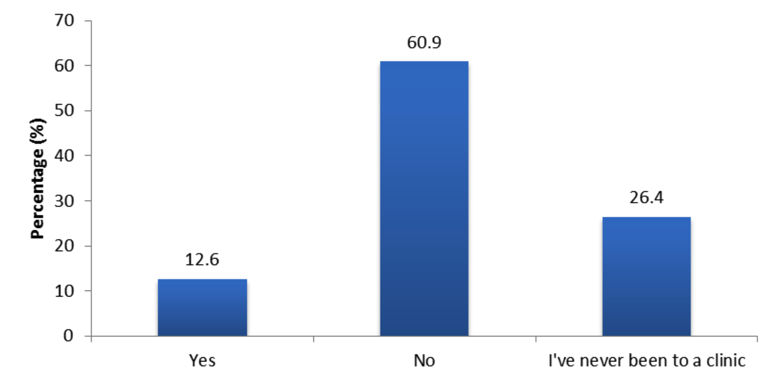
Digital lives: apps, social media and sex
Digital Lives: Discussing social media at the clinic
Have you ever discussed using apps/social media to meet with someone at a sexual health clinic? (n=87)

Slide 19
Digital lives: apps, social media and sex
Digital Lives: Discussing social media at the clinic
One FAQ contributor shared this experience:
I brought up meeting guys via Grindr at the (clinic named) and got a very negative response from the nurse, feeling massively judged. I won’t mention it again. (FAQ Online response)

Slide 20
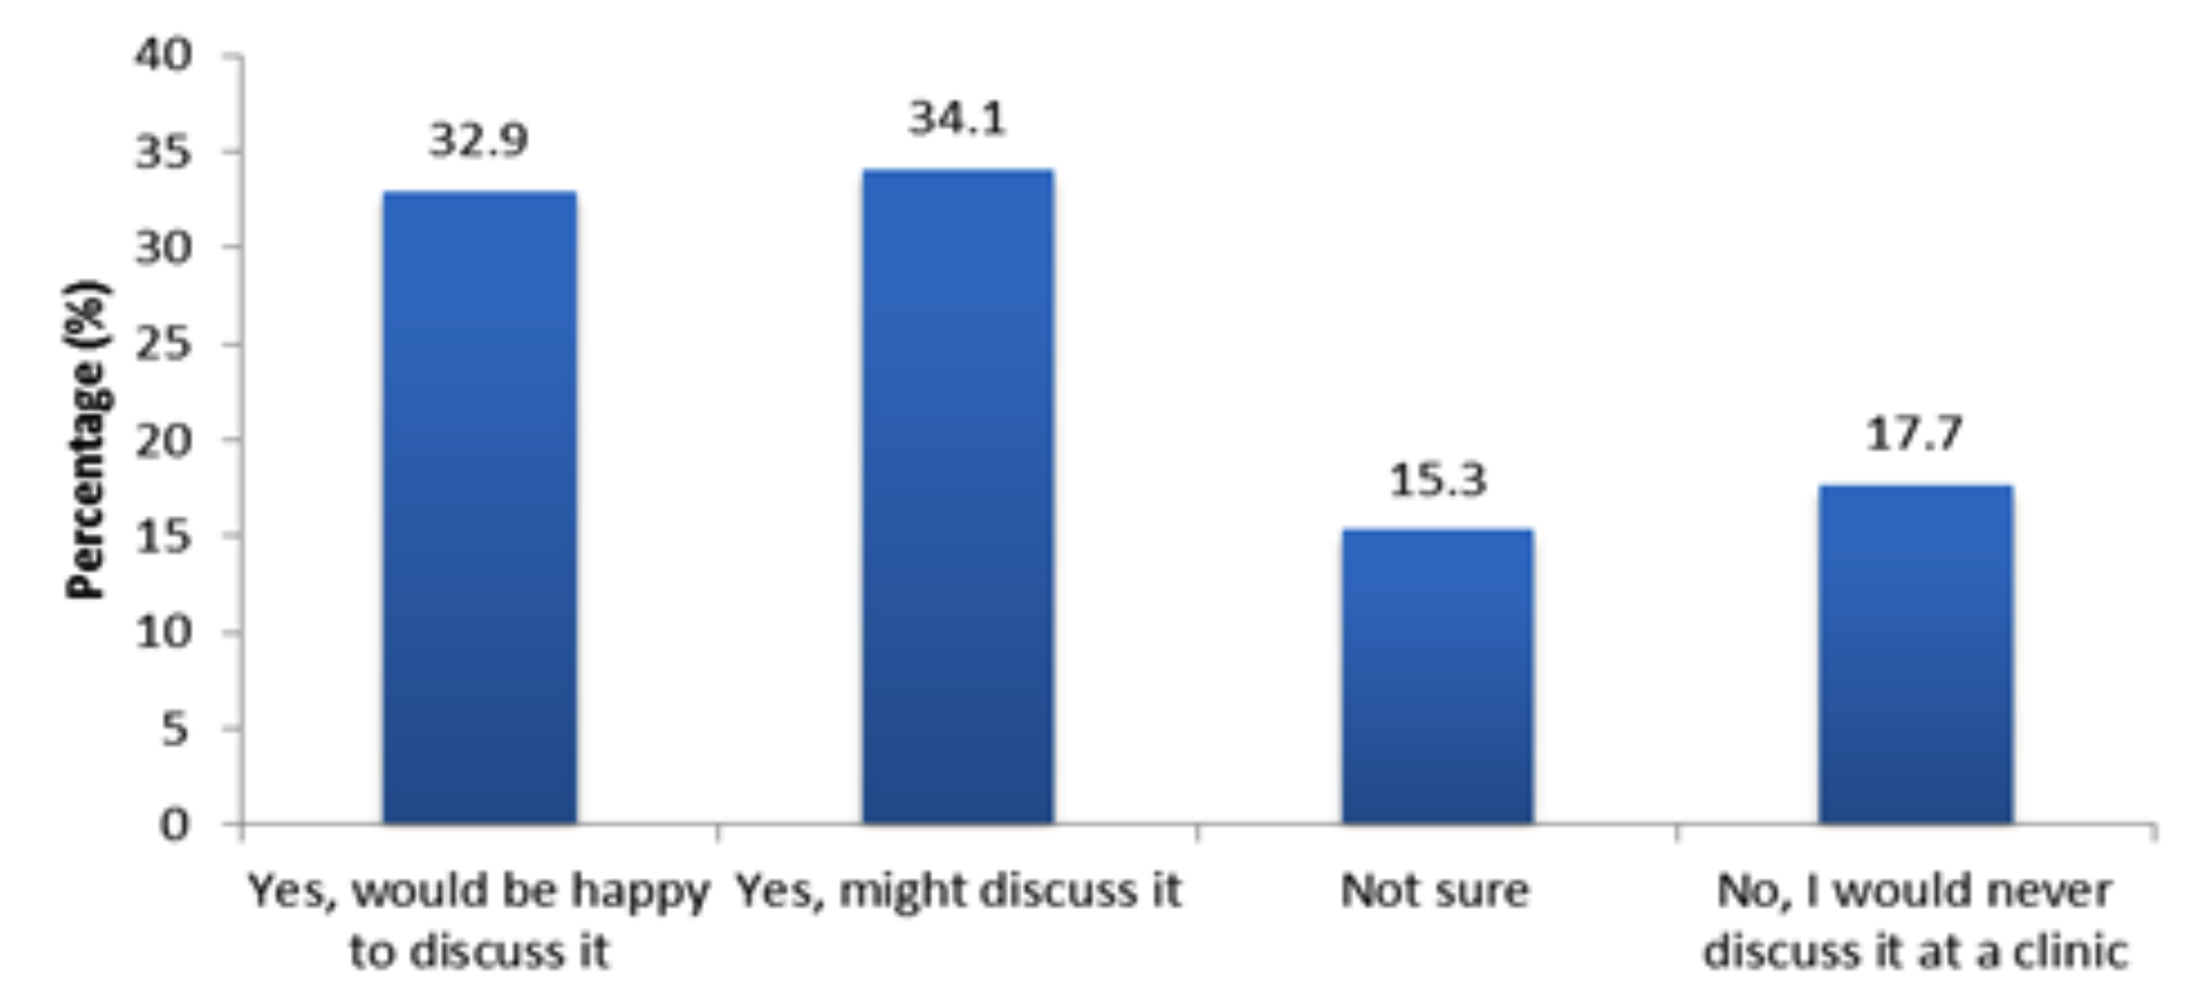
Digital lives: apps, social media and sex
Digital Lives: Discussing social media at the clinic
Would you ever discuss using apps/social media to meet guys with someone at a sexual health clinic? (n=85)

Slide 21
Digital lives: apps, social media and sex
Discussion
In FAQ interviews men identified that conversations with clinic staff about using apps and social media might help them consider personal safety, how to negotiate safer sex and reflect on worries about using the medium. Many more men were willing to consider conversations at the clinic than were actually having them.
How confident do you feel that you can provide such an opportunity?

Slide 22
Digital lives: apps, social media and sex
Please take a moment to note down some thoughts on the reflection sheet.

Slide 23
Digital lives: apps, social media and sex
Further information
HIV Prevention Needs Assessment (NHS Lothian and NHS GGC) www.scotland.gov.uk/Topics/Health/Services/Sexual-Health/HIVMSMNeeds
FAQ Scotland Chapter 17: Social Media/Apps at: www.faqscotland.co.uk
A report on NHS Clinical Staff interviews (part of the HIV Prevention Needs Assessment) www.scotland.gov.uk/Topics/Health/Services/Sexual-Health/ HIVMSMNeeds/interviews
Social Media, Lanarkshire Men who have Sex with Men and Sexual Health
http://www.sexualhealthnetwork.org.uk/wp-content/uploads/2014/05/SMMaSH-Qualitative-Report-Final-For-Circulation1.pdf
http://www.sexualhealthnetwork.org.uk/wp-content/uploads/2014/05/2014-05-23-01.38.46-PM-Lanarkshire-SMMaSH-Survey-Report-2013-For-Circulation.pdf

